Slide 1


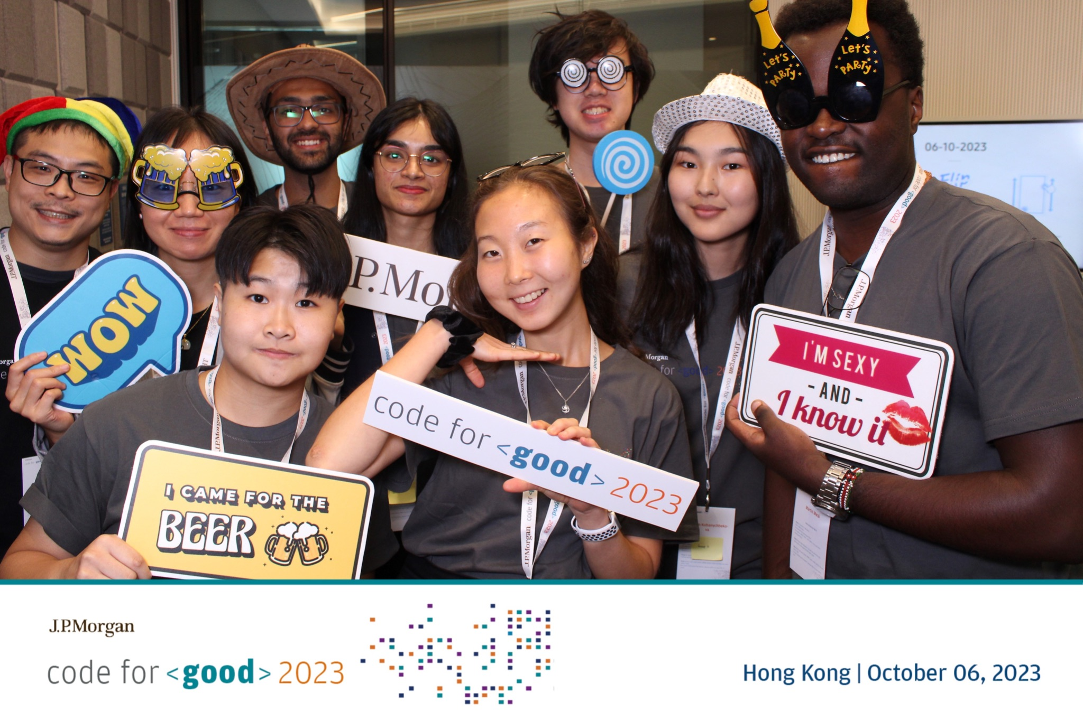

🦖
Team 6
🦖

Slide 2

Key Features
Weekly Challenges
Discussion Forum
Shopping Cart
Data Visualization

Slide 3

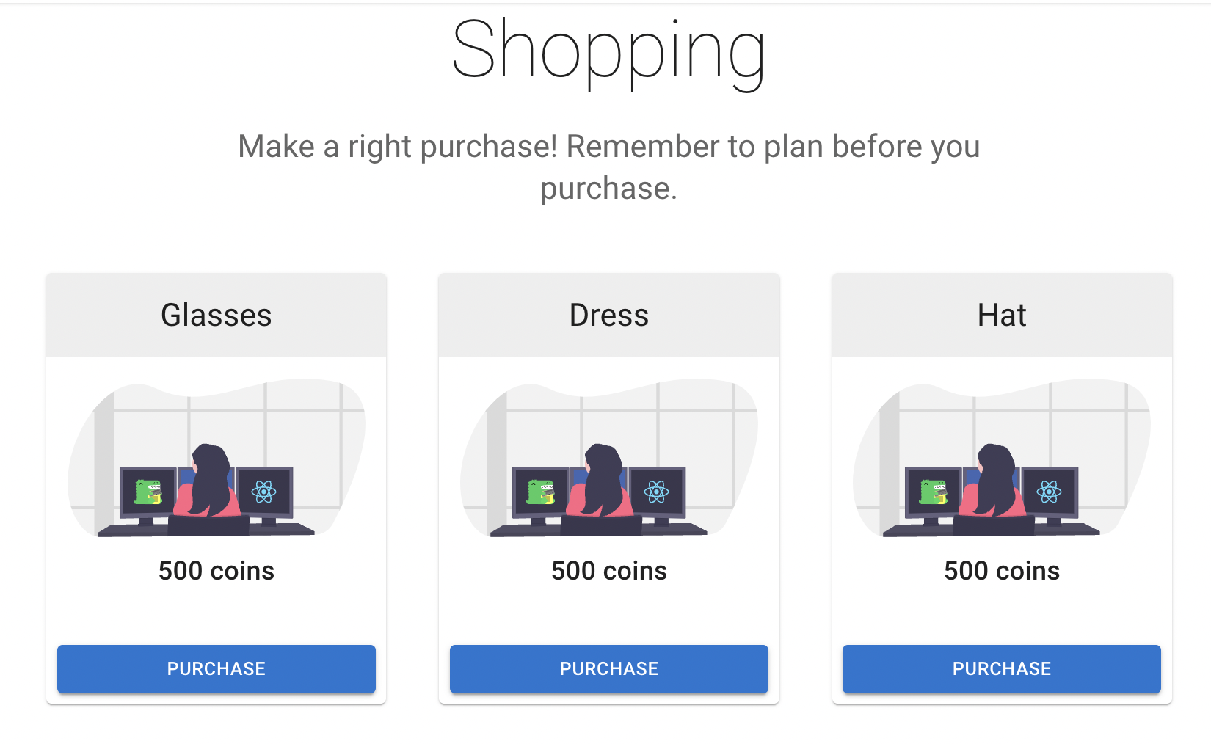
Shopping cart
Purpose: Teach wise purchasing and enhance shopping enjoyment.
Interactivity: Gamified experience for understanding budgeting and money value.
Educational Content: Real-time budgeting advice and spending insights.
Product Range: Wide variety for avatar customization, from hats to socks.

Slide 4
Data Visualization
Purpose: Provides visual data representation for easier analysis by administrators and teachers.
Benefit: Supports decision-making, customizes teaching, identifies improvement areas for enhanced educational outcomes.

Slide 5

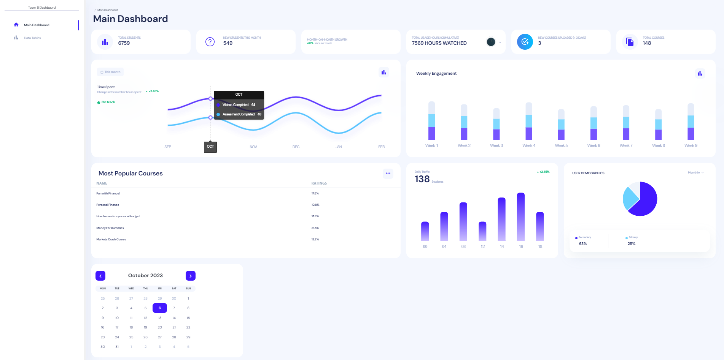
Data Visualization

Slide 6
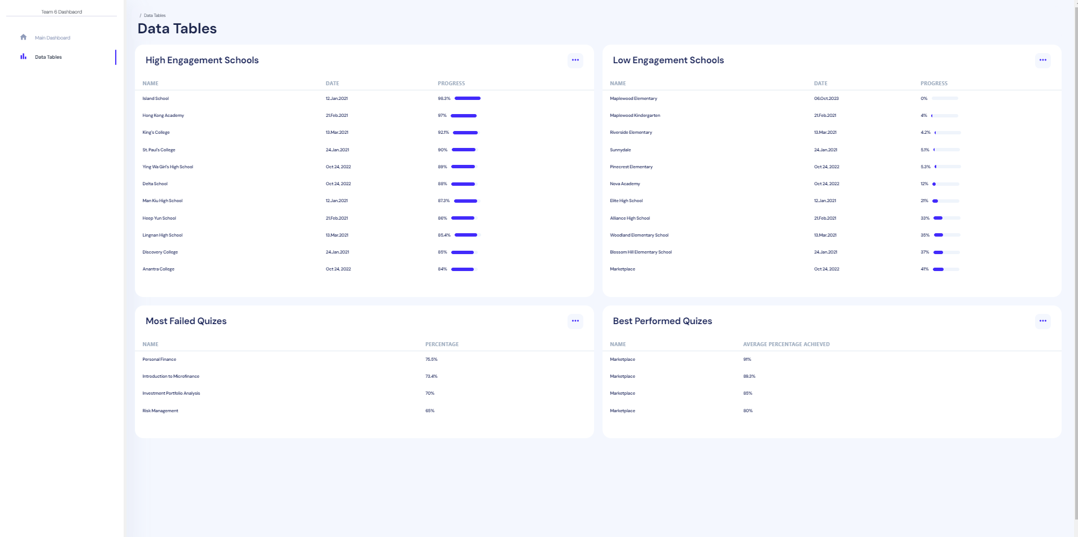
Data Visualization

Slide 7
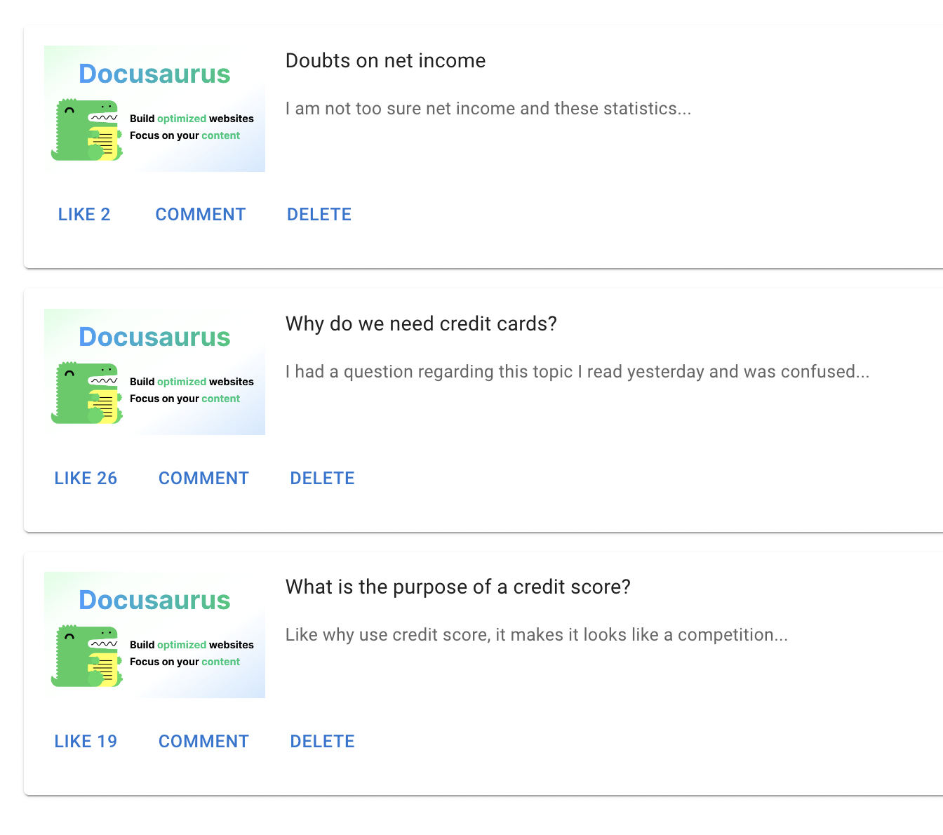
Discussion Forum
New way to learn: Students can also learn through the process of reading others’ discussions and posting their own comments
Purpose of the Feature:
- increase peer interaction and engagement
- allow them to ask questions and discuss concepts.
Interactive Experience:
Students:
Give a like
Add their own comments
Edit and delete their discussions

Slide 8
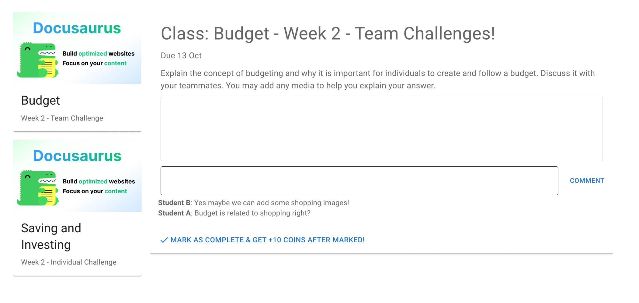
Weekly Challenges
Purpose of the Feature:
Motivate students to test their understanding by answering weekly questions.
Competitive Experience:
Answering the questions is given a rank on a leaderboard.
Motivation to perform well to get a better ranking.
Earn Coins for Shopping Cart:
Trying Weekly Challenges can help students earn coins
Coins used to purchase items from the Shopping Carts

Slide 9
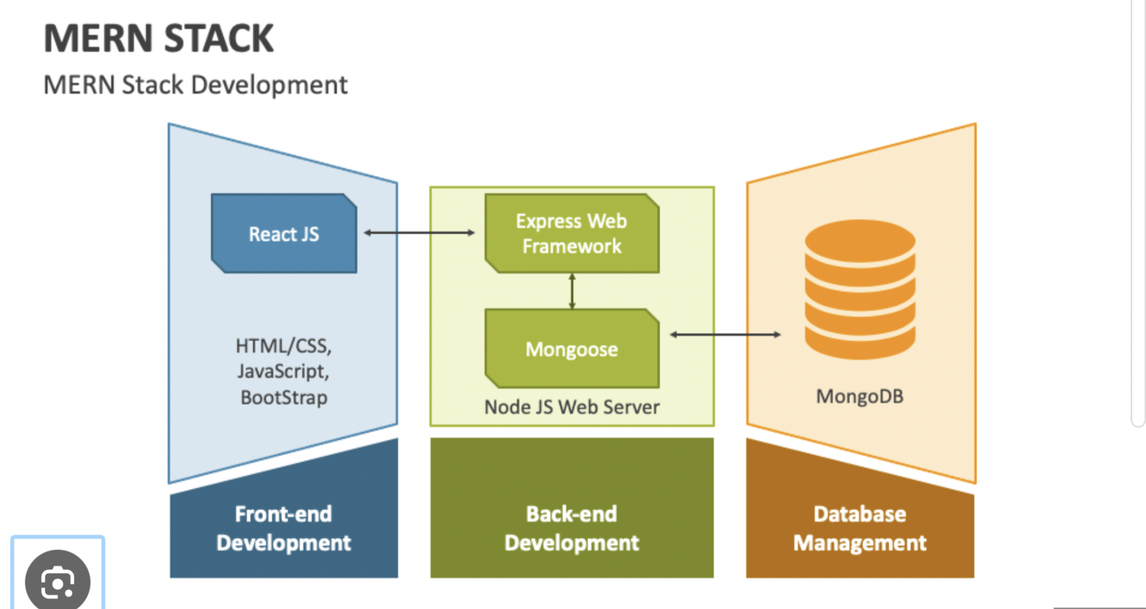

Architecture
Model-View Controller
Scalability
Code Maintenance (multiple Tiers) -> Stability
Cost Saving (Open Source)
Strong Community

Slide 10

Future enhancement
01
An AI Chatbot
02
Notifications feature
03
Pixel Arts

Slide 11

THANK YOU

